Slide 1
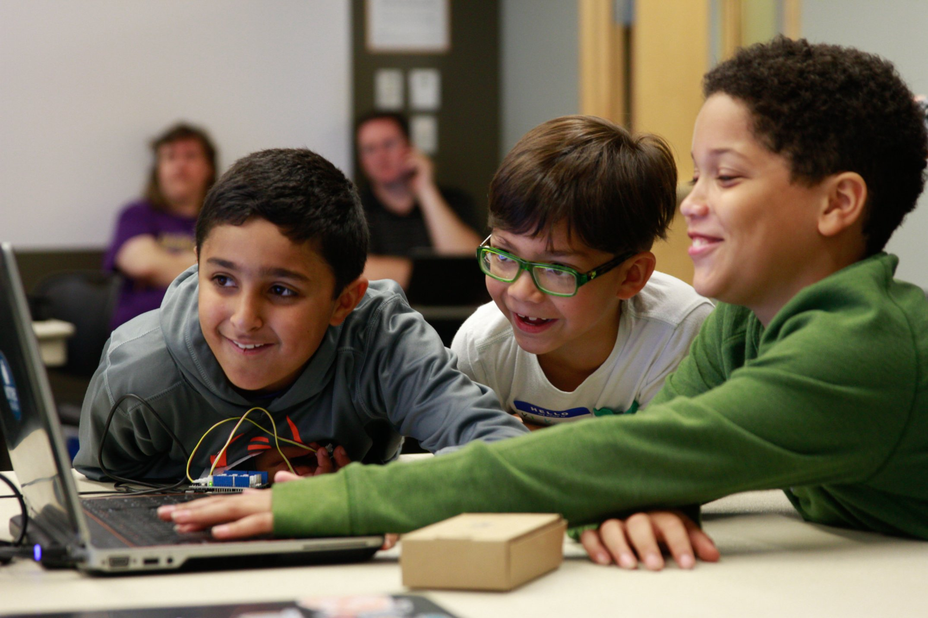
Greg Bulmash
@YiddishNinja
http://Yiddish.ninja
Kids & Devs
Teaching Tech to Both
Photo by Margie Nicosia, used with permission
Notes:
I’m Greg, talking on teaching tech to kids and devs.

Slide 2

Who am i?
Video by Avalara, Inc.
Notes:
With that said, I am no longer a Developer Evangelist at Avalara. I’m actually headed to Amazon next week.

Slide 3
Credentials
Courseware Developer for Nortel 1990s
Created IMDb user help section “IMDb University” used 1999 – 2003
Programmer Writer – Microsoft - IE Developer Center 2012 – 2015
Lead Organizer and instructor – Seattle CoderDojo 2013 - Present
Notes:
EXPLAIN CODERDOJO!!!

Slide 4

The plan
Understanding the two audiences
Prep & planning
Doing the teaching
Artist: ZeusBox Studio (work for hire) – Owner: Greg Bulmash

Slide 5
MOTIVATION
Reason for learning the topic?
Reason for attending a class?
Notes:
First thing I’m going to tell you is they’re not as different as you might think.
Might think kids are there out of curiosity and thirst for learning while adults are looking for a job skill.

Slide 6
MOTIVATION
Reason for learning the topic?
Kid: Because it’s fun
Adult: My boss is making me
Reason for learning the topic?
Kid: My dad is making me
Adult: Because it’s fun
Notes:
There are a variety of reasons… I had an ultimatum to become more “fungible” at Microsoft once, and until I asked for training budget was being told I had to learn C#. Meanwhile in my last job, I got a chance to dive deeper into node for projects I initiated particularly because I wanted to learn more node.
If most of the group is there because they have to be, you’ll have to work harder to get and keep their attention. If they’re all there for fun, you’ll have to work to keep up with them.

Slide 7
MOTIVATION
Reason for taking a class?
Both: To have someone to help
Both: To have someone else set the pace
Both: To join a F2F learning community.
Notes:
This is another area where kids and adults are going to converge.
Whether it’s playing guitar or programming a computer, having someone on hand to help you can be a big part of whether you succeed or fail. It’s not just being a self-starter, it’s when you hit that first bump or two in the road and have to spend what feels like an hour reading through Stack Exchange and forums where the question might or might not be answered, and if it’s certain company support forums, answered by tech support staff who cut and paste irrelevant boilerplate. Having someone who knows the topic right there to help you can be a huge motivator for learning in-person or via a live interactive feed rather than with automated courseware or a book.
How many times have you bought a book and never gotten around to getting through it. Signed up for self-paced class and never finished it. Sometimes having the physical task of going to class at an appointed time helps keep you on track. Even with courseware. We have 5 teens doing the FreeCodeCamp.com certification program and we have set an instructor aside as an advisor who reviews the week’s exercises.
Learning communities also help. They support each other, create a sense of belonging that helps drive learning (a sort of positive peer pressure to learn), a chance to interact with people who are going through what you’re going through.

Slide 8
Knowing basics
Kids won’t know/have things we take for granted with developers.
Most seven-year-olds don’t touch-type.
Notes:
When kids were typing in code they saw on screen, we’ve had problems with them using a double single-quote instead of a double-quote.
Depending on the level of the workshop, you may be starting from absolute scratch. Kids might not even have e-mail addresses (remember that the official minimum age for a Gmail account is 13).
Talk about “The Myth of I’m Bad at Math” and how it influenced my views. How the willingness to try harder, study more is more important than innate talent. Plenty of geniuses collect unemployment.
Engage with audience about soft skills like patience with the process and themselves, determination and tenacity to bang their head against a bug or a tricky concept. Most devs have learned these skills, but a lot of kids coming to it for the first time. This is why we say that coding, like playing piano or shooting free throws takes practice and desire,,, practice to get better, desire to do the practice even when it’s a little frustrating or you’d rather be watching TV.

Slide 9
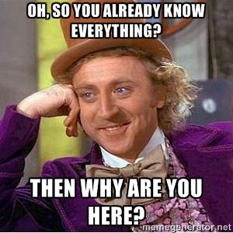
Doctors are bad patients
Notes:
You’ll run into it less with kids, but more with adults. Because they have expertise in the field, they get overconfident, “I got this, bro.” Then they dive in without reading the instructions, miss a crucial step, and end up lost partway through with an error they can’t resolve.
I bring this up not only because I’ve seen it, but because I’ve done it. Most recently at a hackathon, I couldn’t get an API to work because their instructions said I needed a temp directory. I simply assumed my system temp would suffice, but I actually needed to create a specific directory where my server-based API client would store temporary data like user Oauth credentials.
Devs are actually more likely to question your logic, your architecture, and be less deferential… because like having a doctor as a patient, teaching tech to a dev will come with the baggage of their estimation of their own skills attached.
Kids, even if they think they know stuff, tend to be more deferential. This gets less likely as they move into adolescence and their teen years, but they’re still at a point in their life where teachers are authority figures.
We’ll talk about this more in the class prep section.

Slide 10
maturity
Technical Ability != Emotional Maturity
Notes:
Talk about “Kenny” – amazingly bright kid, eats up tech, we have trouble keeping up with him, does all sorts of projects on his own… the kind of kid CoderDojo was made for. But remember despite the fact that he’s more tech savvy and possibly smarter than a lot of adults, he’s still 10. He still needs a snack, still needs

Slide 11
The plan
Understanding the two audiences
Prep & planning
Doing the teaching

Slide 12

Why are we here?
Photo by RelaxingMusic – license CC-BY – Source: Wikimedia Commons
Notes:
Coming back to motivation, understanding what your audience is looking to get out of the presentation or workshop is a key factor in your design.
Are they looking for practical they can put to use or to simply get an overview?
Practical knowledge often means hands-on work is needed.

Slide 13
Audience participation
Especially important in presentations without hands-on exercises.
What are ways you can encourage audience participation?
Notes:
If you’re not providing hands-on exercises, it’s necessary to engage the audience and get them involved. It wakes them up, perks them up.

Slide 14
Procedural v. conceptual
Procedural: How do I do it?
Learning the latest office suite
Conceptual: Why do I do it this way?
Learning to program
Notes:
Every time Microsoft changes how Windows or Microsoft Office works, what happens? People lose their damn minds.
Learning styles have been mostly debunked in studies. But procedural and conceptual learning is a real thing and you should account for both types.
Sometimes there’s no reason to go beyond the procedural. Even if your audience is full of smart, techy people, there’s not a lot of conceptual in learning a new email client or conferencing system.
But depending on your topic and your audience, the why can be more important than the how. For example, when teaching global vs. function scope in JavaScript, the why of declaring variables inside functions (or not) is important. The why helps you understand the when.
Teaching kids or devs to use an efficient pattern is good. That might be the “how.” When they learn there are 4 other ways to skin that cat, some of which seem easier, it’s the why that keeps them sticking with it.

Slide 15
MOTIVATors
What motivators can you offer?
Both: Certificates of Completion
Both: Attendance Swag
Adults: Prizes get attention
Kids: Prizes have pitfalls
Notes:
Attendance swag – shirts, stickers, take home the tech they worked on. PiDay with Century Link
Why do I say prizes have pitfalls – I won a gift card and $20 at company orientation. No one complained that they didn’t win and quit.
Tell tale of Bingo and kid who withdrew. And while you might say “what a bad parent?” It’s not our job to instruct parents in how to parent.

Slide 16
required hardware
Kids are more likely to have hand-me-down or borrowed hardware. Sometimes REALLY old.
Parents will sign up three kids and bring one laptop.
Notes:
There’s a difference between teaching random adults and teaching devs. Devs will likely have newer hardware with administrator permissions. Random adults may have new hardware and permissions or they could be on a 4-year-old work laptop with a 15-minute battery life that has been locked down by IT to protect them from themselves.
Think of kids as random adults, but they’re likely to have it worse… hand-me down equipment (we had a kid with a Powerbook G4 at our first Hour of Code in 2013 – they wanted to do a Flash-based tutorial and couldn’t get an updated version of Flash because Adobe had stopped producing Universal Binary versions), they might have their parent’s locked-down work laptop. They might have a Chromebook and their parents didn’t know it couldn’t keep up.
If you can’t provide hardware (for all or limited-supply loaners) consider how you’ll deal with old hardware and SHARED hardware. If you won’t be providing hardware, be explicit up front about minimum specs and that it is BYO.

Slide 17
required software
Pre-Install or Install in Workshop?
Are accounts needed?
Notes:
Kids may be the most tech savvy people in their home. If they’ll need help installing, it’s best to do the install in class. Depending on the complexity, that may take up all or part of a session, so prepare for that. My minecraft modding workshop spends the first session on getting kids set up with the modding environment.
If it’s simple, make sure the list of what needs to be installed is in the description where people sign up, is on your web site, and is emailed to them as part of the confirmation/reminder emails.
If possible, make an office hour before class where people can get help with installation.
Account permissions are even harder than software if people need to get them in class. Imagine 30-40 people on the same WiFi, thus coming from the same IP address, trying to sign up for a service all at once. You’ll run into explicit and not-so-explicit throttling if not outright IP banning. We stress... STRESS that parents sign up for Mojang accounts before they come to the Minecraft class, because they throttle.
Additionally, in many cases, if a site doesn’t cater to kids, they don’t want the headaches of COPPA (Child Online Privacy Protection Act) and their TOS may expressly prohibit kids under 13. So sign up the parent and let the kid use that account. Fine, but what if they’ve got multiple kids? This gets even trickier on accounts that require a credit card, because the parent might sign up both kids and the second gets rejected because they can’t do both kids on the same card.
These ae things you have to consider that you don’t with an adult student who has their own email address and credit card.

Slide 18
Fuzz Every Step
Go through your directions and intentionally skip steps.
Intentionally get things wrong.
Notes:
If you’re doing installs or hands-on work, try to figure out AND EXPERIENCE as many ways of getting it wrong as you can. You can’t predict all the ways your students will get things wrong, but if you’ve got the top 80%, your debug time will go down. There’s nothing worse for a student than getting hung up on a problem that cannot be quickly debugged and then being left behind because the class has to move on.
Remember, Devs will make mistakes, not just kids.

Slide 19
supplements
Learning aids for in-class
Hand-outs for after class
Notes:
Having code they can copy from Pastebin or a fiddle is useful, especially when they’re younger. Remember how I said 7-year-olds don’t touch type. For children in that age range, it’s often better to have code they can modify

Slide 20
The plan
Understanding the two audiences
Prep & planning
Doing the teaching

Slide 21

NO
Photo by Ryan McGuire, gratisography.com – licensed CC0
Notes:
Don’t be a clown. Some presenters / teachers may be naturally funny, but balancing humor with teaching is a skill. If you go overboard, it will get uncomfortable… just like you’re getting more and more uncomfortable looking at this clown.

Slide 22

Two types of ?s
Those asked to gain knowledge
Those asked to demonstrate knowledge.
Art CC0 licensed – Source: openclipart.org
Notes:
Why do I say prizes have pitfalls – tell tale of Bingo and kid who withdrew

Slide 23

Self ADVOCACY
Ask parents to stay with quieter kids and advocate for them.
Check in with your quieter adults during breaks.
Photo by Brenda Gottsabend – license CC-BY-NC – Source: Flickr
Notes:
Both kids and adults can be afraid to ask for help for a variety of reasons. They may feel uncomfortable speaking up in public for fear of looking stupid, may simply have social anxiety, may not know how to describe what’s confusing them.
OPEN ENDED QUESTIONS – “Where you at? What you working on?” Nothing they can answer with one word.
We require parents to be on-site at CoderDojo and suggest that those with quieter kids sit with them and be their advocates. But with adults, while many more are more confident, you’ll still have a few who are uncomfortable speaking up. Those are the ones you have to try to connect with at breaks and ask if they need any help.

Slide 24
Presentation tip
Never put a really text heavy slide on the screen because people will spend their time reading it instead of listening to you. And if all you’re doing is reading the slide to them, that’s boring.

Slide 25
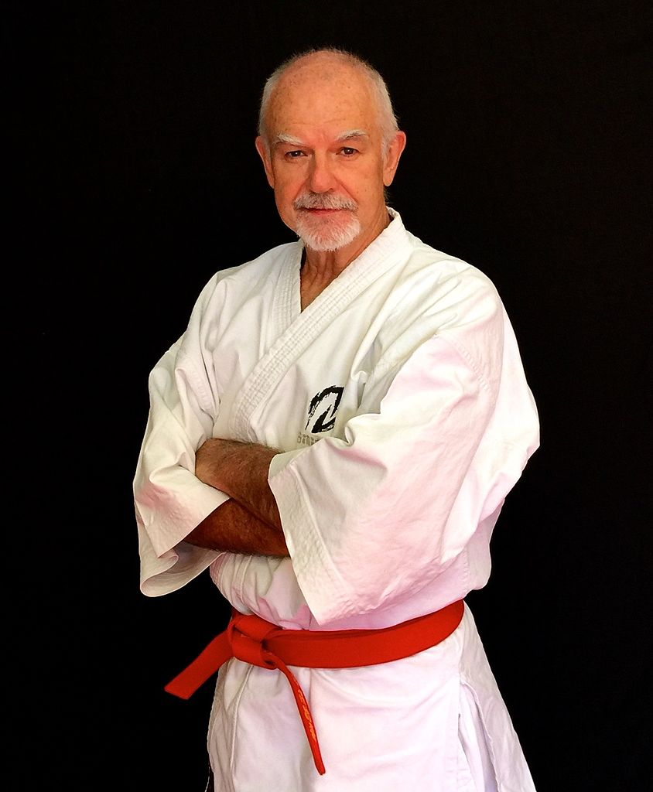
Be their sensei
You are their teacher, not their parent.
You are their teacher, not their manager.
Photo of/by Sensei Patrick McCarthy – license CC-BY – Source: Wikimedia
Notes:
Remember your role here. You’re there to facilitate learning. You are not there to monitor their use of Facebook, force them to pay attention, discipline them for not turning in assignments. If you’re an elementary school teacher, you may see this differently, but if you’re teaching kids with a volunteer program or doing classes for professionals, you have to define your role.

Slide 26
Stay in touch
Twitter: @YiddishNinja
Blog: http://Yiddish.Ninja
Email: gregb@seattlecoderdojo.com
I have Ninja Kitten stickers!
Notes:
Remember your role here. You’re there to facilitate learning. You are not there to monitor their use of Facebook, force them to pay attention, discipline them for not turning in assignments. If you’re an elementary school teacher, you may see this differently, but if you’re teaching kids with a volunteer program or doing classes for professionals, you have to define your role.

